Slide 1

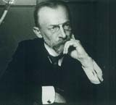
Towarzystwo Naukowe Organizacji i Kierownictwa TNOiK
Scientific Society for Organisation and Management is a non-governmental, non-profit organisation
The Society was established in April 1925 as the Institute of Scientific Organisation - one of the first management associations in the world. Its founder, Professor Karol Adamiecki was the pioneer of the theory of organisation, creator of the harmony theory and also, together with H. Hoover and T. Masaryk, the cofounder of World Management Council
prof. Karol Adamiecki

Slide 2

Since 1926 TNOiK is the publisher of a monthly magazine “Przegląd Organizacji” - "Organisation Review”. It is a journal for managers, scientist, students and people who interest in managing. It is devoted to economy, management and theory of organisation, bringing interviews, feuilletons, scientific reports, reprints from foreign magazines.

Slide 3
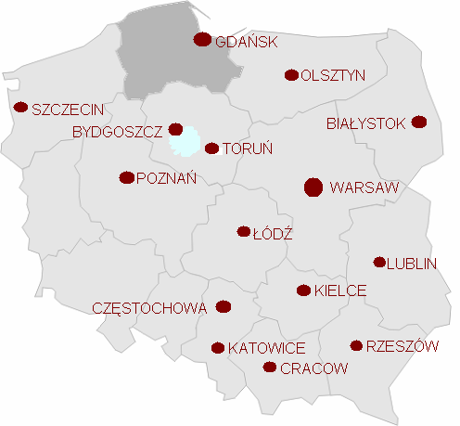
TNOiK’s Central Board is situated in Warsaw, but the society operates through 15 regional branches
If you look for a professional, competent and experienced partner contact us:
TNOiK Oddział w Gdańsku
Al. Grunwaldzka 8
80-236 Gdansk, Poland
tel. +48 58 3419379
fax +48 58 3414511
e-mail: tnoik@tnoik.gda.pl
www.tnoik.org

Slide 4

Our mission is:
The promotion and creation of professional management as well as the integration of scientists and practitioners (entrepreneurs and managers) for the development of Polish economy and Polish state.

Slide 5
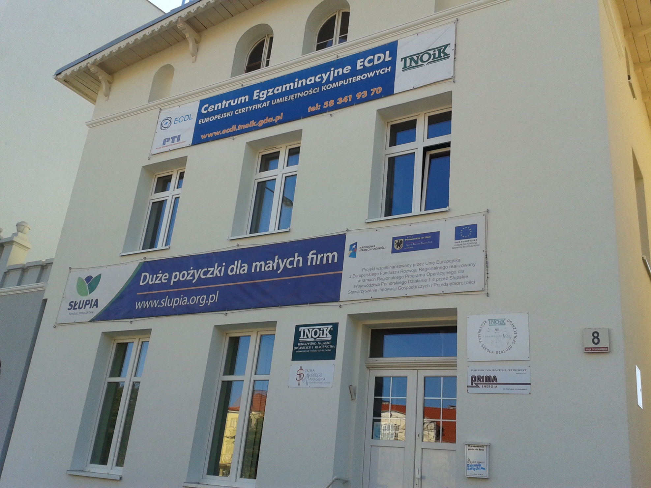
TNOiK Gdansk Branch

Slide 6
Members of TNOiK Gdansk are:
Scientists, representing the main universities of Tri-City
Entrepreneurs
Managers
Headmasters of Vocational Schools
Officials

Slide 7
Main activities of TNOiK Gdansk Branch
  We realise European research and educational projects (especially in frame of Life Long Learning Programme).
  We are a non-formal training institution for companies, public administration, NGOs and individuals.
  We organize workshops, conferences, seminars, and study visits.
  We are Accredited Test Centre for European Computer Driving Licence ECDL.
  We promote social and citizen dialogue as well as we provide public consultation processes in big infrastructure projects.

Slide 8
Co-operation with the local self-government
  Project Grandparents and Grandchildren – intergenerational computer workshops for elder people
  Project Gdansk School of citizen dialogue
  Young Manager’s School – the programme that was realised since 1991 to 2009 and which has been completed by 850 participants in 30 courses
  Public consultations within the projects socially important: e.g. (1) building of the waste combustion plant in Pomorskie Region, (2) building of new northern ring road of Tri-City metropolis.

Slide 9
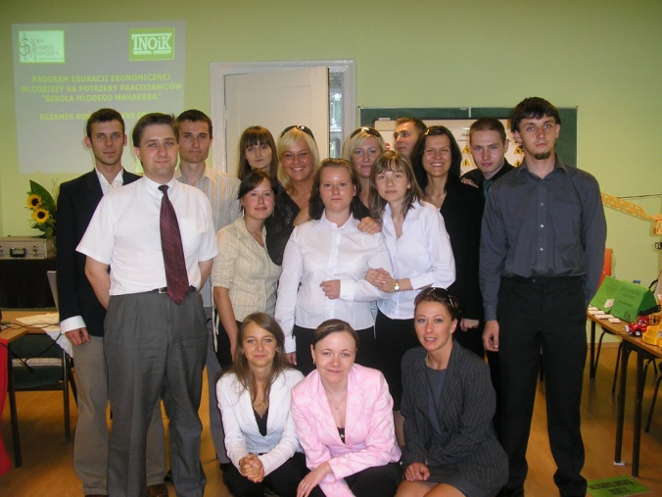
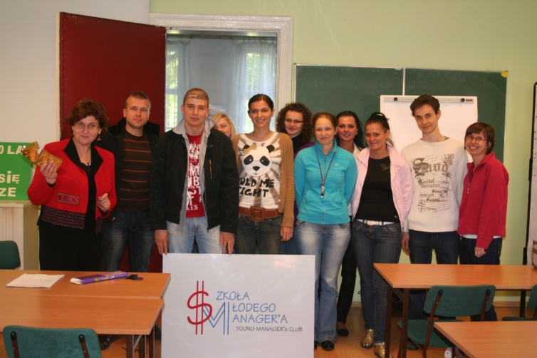
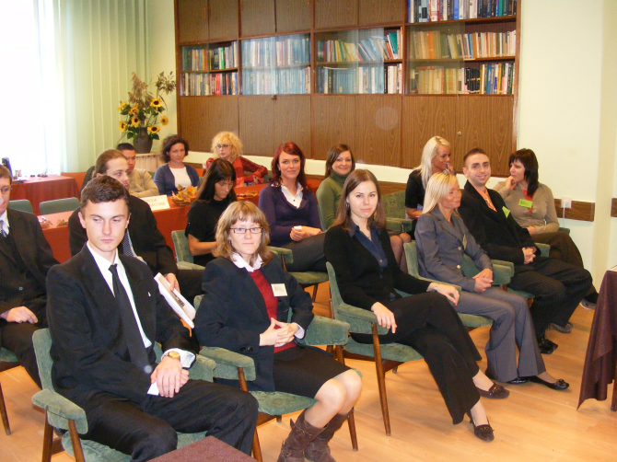
SMM - Economical Training Program for Young People
We had about 900 students in 30 editions, during 18 years of SMM

Slide 10
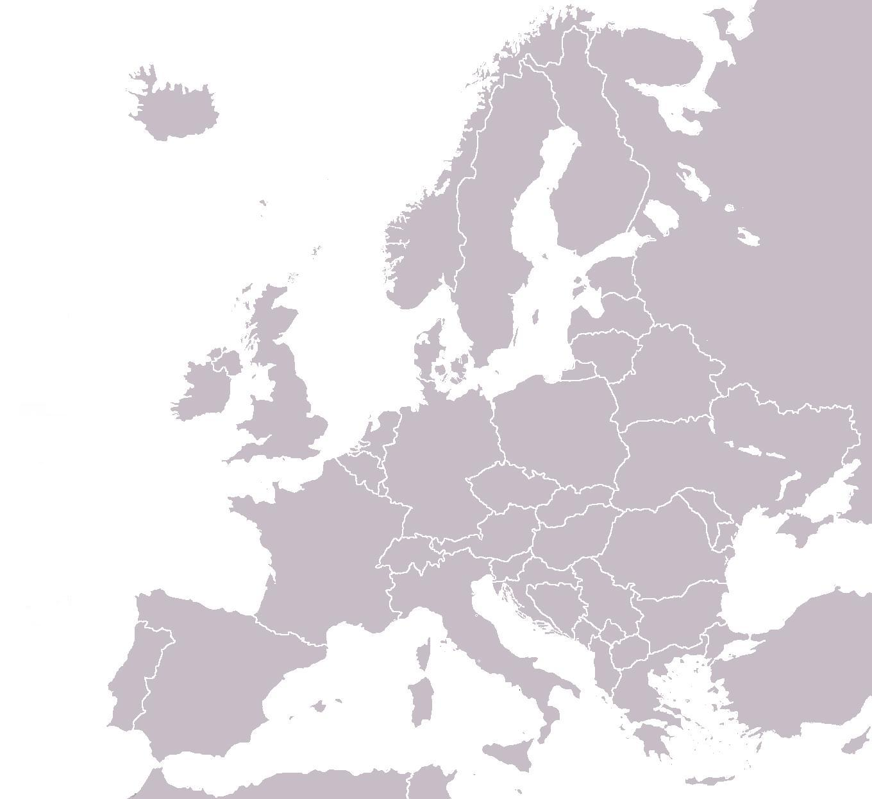

The most important EU projects realized between 1998-2014
Leonardo da Vinci Regional school of social dialogue
Community Initiative EQUAL Model system of knowledge management in a company
Leonardo da Vinci CRE’ACTOR
eLearning Grandparents & Grandchildren (G&G)
Leonardo da Vinci TOI Europass+
Leonardo da Vinci TOI Europass+2
Leonardo da Vinci TOI MAPCOM
Leonardo da Vinci TOI MAPCOM2
Leonardo da Vinci TOI SkillsUp
Leonardo da Vinci Multilateral Networks Go&Learn
Leonardo da Vinci TOI Quality by units
Leonardo da Vinci TOI TRACK

Slide 11






Our current EU projects –
with 14 partners from 6 countries
Erasmus+ SWORD - School and WOrk-Related Dual learning
Leonardo da Vinci TOI ECVET-BUD
Leonardo da Vinci Partnership projects Labor Market Competenies
European Social Fund (POKL) International cooperation for the development of Pomeranian SMEs

