Slide 1




SWORD (School and WOrk-Related Dual learning)
Final Conference
Trento, August 29th 2017
Challenges of the Dual System
The View from Hamburg
Background – Objectives - Results
Gunnar Binda (HIBB)
Hans Thormählen (Arbeit & Leben Hamburg)

Slide 2
Dual VET in Germany
Education Authority
for VET (HIBB)
Timing of the alternance
Chamber
Training regulations
Framework
Curriculum
Standards
for school
curricula
General Trainingplan
Ind. Training
Plan
Registering of apprentices
VET school
Company
Departments
Additional Modules
School curriculum
Contract
Diary
Certicates per year
Report
Interim
exam
School leaving
certificate
Staff
Trainer
Apprenticeship
leaving exam
Teacher

Slide 3


Dual Collaboration School - Company
Education Authority
for VET (HIBB)
e.g. alternance
ordinance specifications
Chambers
VET school
Strategic aims
Companies
School board
Principle and representatives of
- teachers : 3
- employers: 3
- trade unions: 3
- students: 2
Operational aims
Teachers
LOK
Learning site cooperation
Trainers

Slide 4



Challenges in VET : Transition to the Labour Market
dual VET
VET school
BSW Hamburg-Eimsbüttel
occupational preparation (dual form)
25% of one grade
(weak pupils)
don‘t get an apprenticeship contract
school of general education
Notes:
Every year we have a big amount of weak pupils without a chance to get an apprenticeship training place. That area is called the transition system and it has been in focus for some years. One element to solve the problems is AV dual, the vocational preparation in dual form. In other words: The purpose of AV dual is a smooth transition to the labour market for young weak pupils.

Slide 5

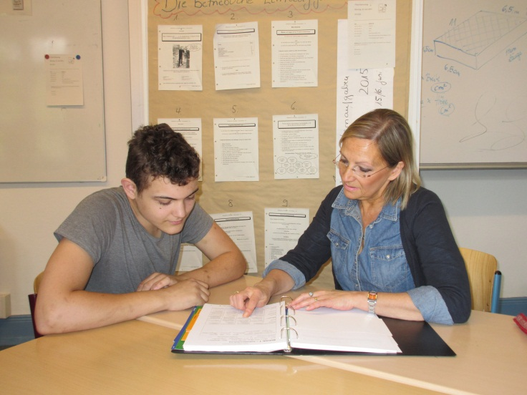
One Success Factor for Effective Transition
Structure of
The qualification starts with an orientation phase at the beginning of the school year
After that pupils will learn and work according to a dual structure, - that is three days in a company and two days at school.
Furthermore a dominant factor for the success is educational support. That means:
Each pupil is supervised by a mentor /
in school and during the internships.
2 days in the school
3 days in the company

Slide 6
Aims of the Pilot
Challenges
Quickly match companies offering internship trainingsplaces with pupils
to get them into internships with the perspective of an apprenticeship afterwards
Development of Instruments for improvement of dual vocational preparation
Guidelines for approaching companies
Guidelines for establishing a network with companies
Database for matching training places and preferences of pupils

Slide 7
Product 1: Guidelines for Approaching Companies
Problems:
How to find companies?
How to approach?
How to convince companies for offering internship training places?
Solution:
Collection of good experiences among colleagues
Development of steps for snowball effects
Development of interview guidelines offering arguments for companies
examples:
assistet training
contact partner in case of problems
long probationary time eases recruitment
…

Slide 8
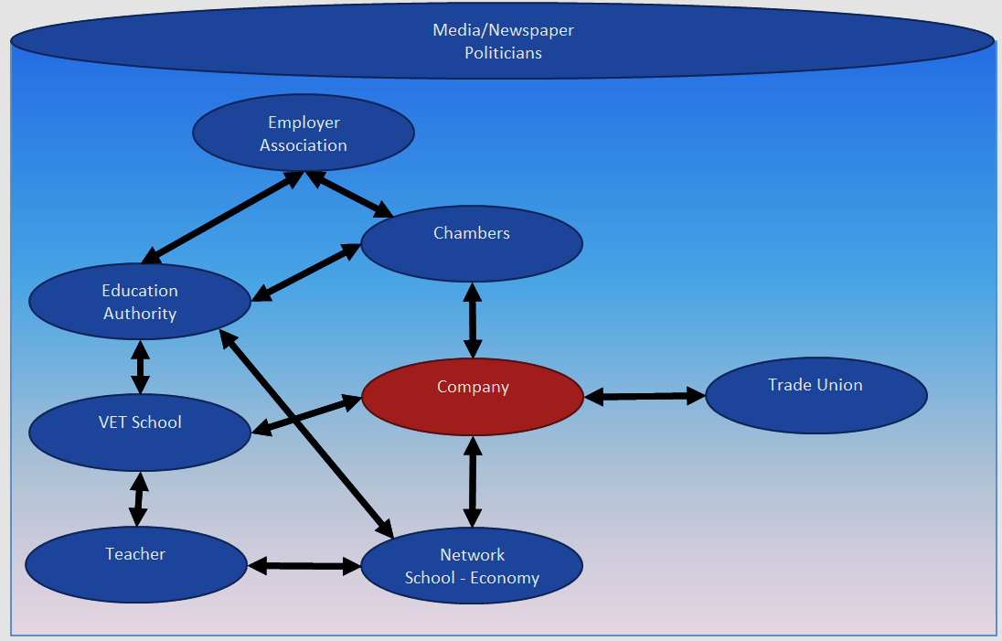
Stakeholder Overview as Basis

Slide 9

Product 2: Guidelines for the Network – „School – Economy“
Implementation of dual VET requires acceptance
Acceptance emerges from strong collaboration
Networks are succesfactors of dual approaches
Successful networks consider compliance with the requirements of all members

Slide 10



The Network „School – Economy“ Needs a Vision
We are the network “school-economy”, competent, sustainable, vital
We create perspectives – for life and occupation
We build bridges – between school and economy
We are committed - local, regional, national, international
We take responsibility for our society

Slide 11
Network „School – Economy“ – Principles and Activities
Operating principles of the network
Regular meetings four times a year
Agreement on aims and working plan
Every meeting has a minute taker
Regular organization of conferences of experts
Topics and Activities of the network
Continuing training
Working groups
MINT – fostering occupations (maths, informatics, nature science, technology)
Professional orientation
Leadership
Economical education

Slide 12
Recent Topics of the network
Internships for pupils of comprehensive and grammar schools
Job orientation and Career orientation
Opportunities for collaboration schools – companies
Expectations of trainers concerning maturity of applicants
Youth Agency
Junior-companies at school and company
The role of parents for professional orientation of pupils
Inclusion
Integrating refugees
Recruitment
Conclusion: The Network has Benefits for Schools and Companies

Slide 13
Golden Rules of the Network
Get a clear political statement concerning “Transition to the Labour Market”
Identify all stakeholders of VET
Analyse real interests of each stakeholder
Define aims and benefits of a network
Make the network a brand including website
Define processes of the network (enquiries, meetings, moderation, statements, recommendations, decisions, communication)
Finance

Slide 14
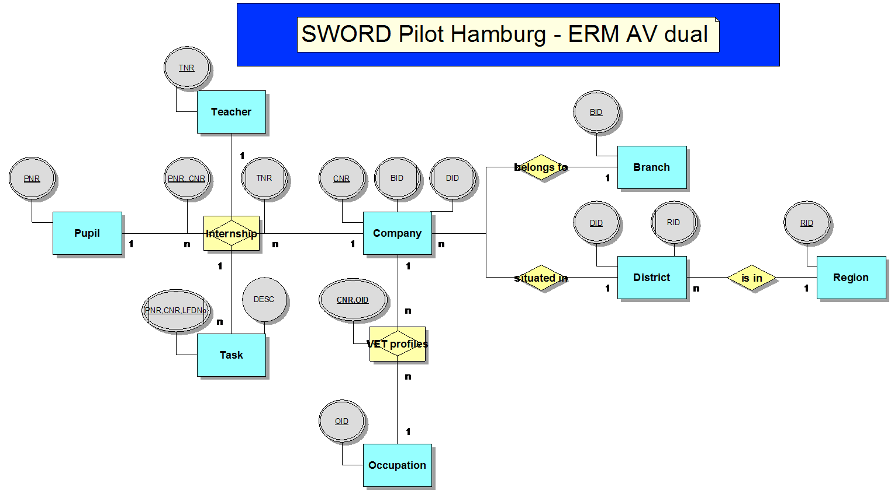
Product 3: The Database for AV dual

Slide 15
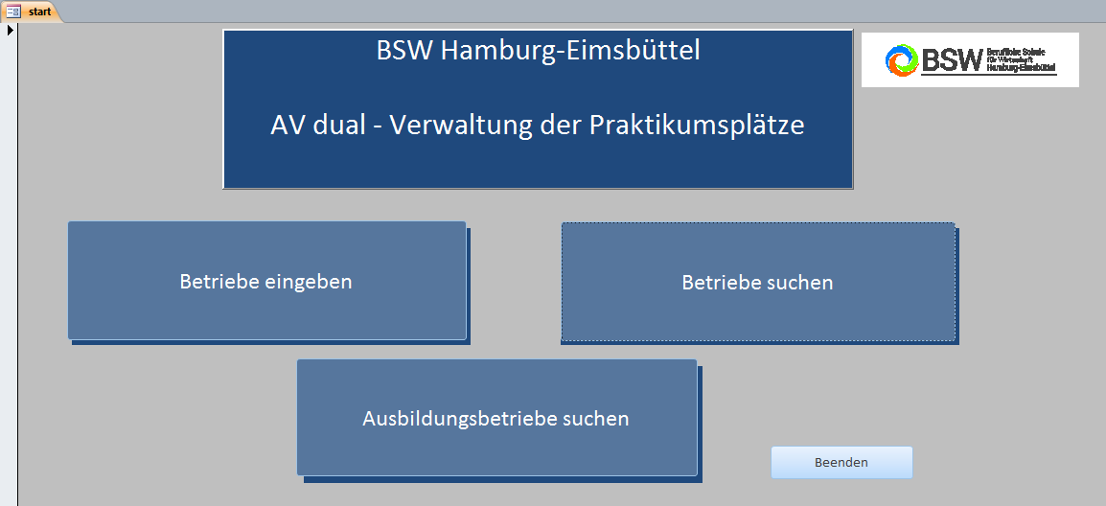
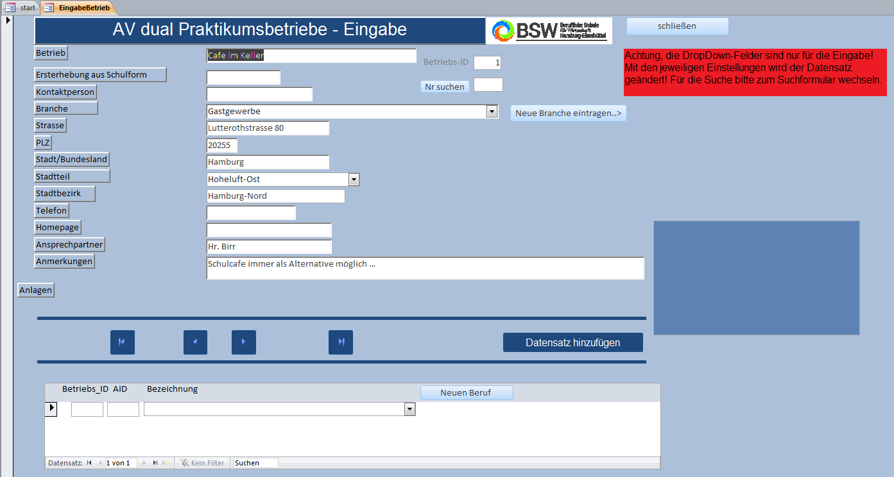
Interfaces of the Database
Dashboard
Confortable
Input Dialog

Slide 16
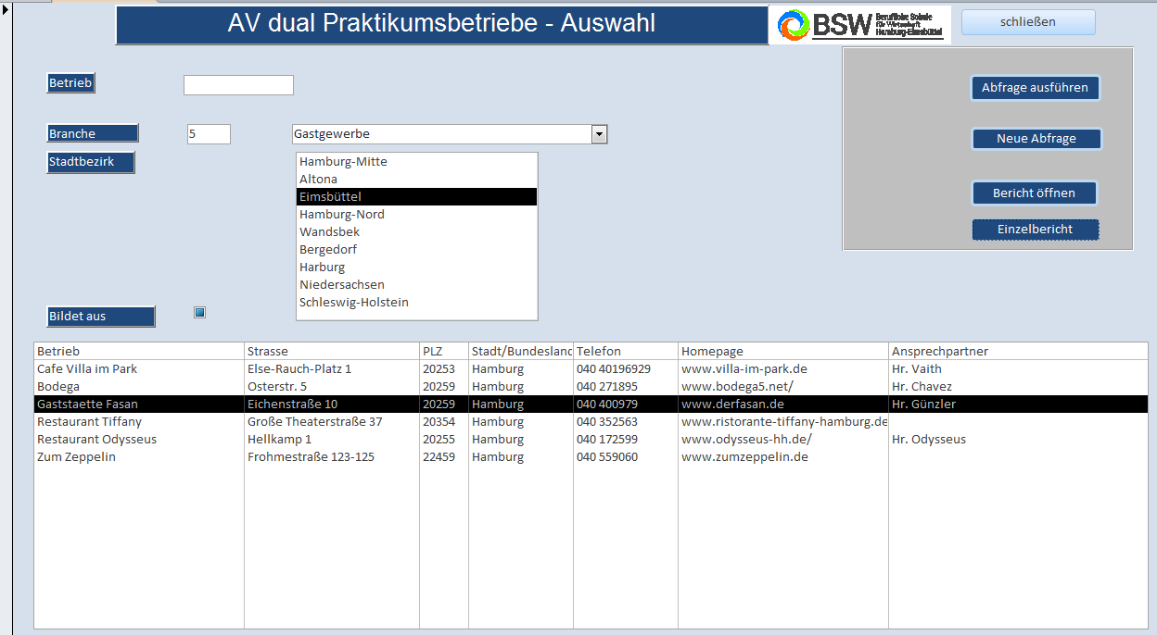
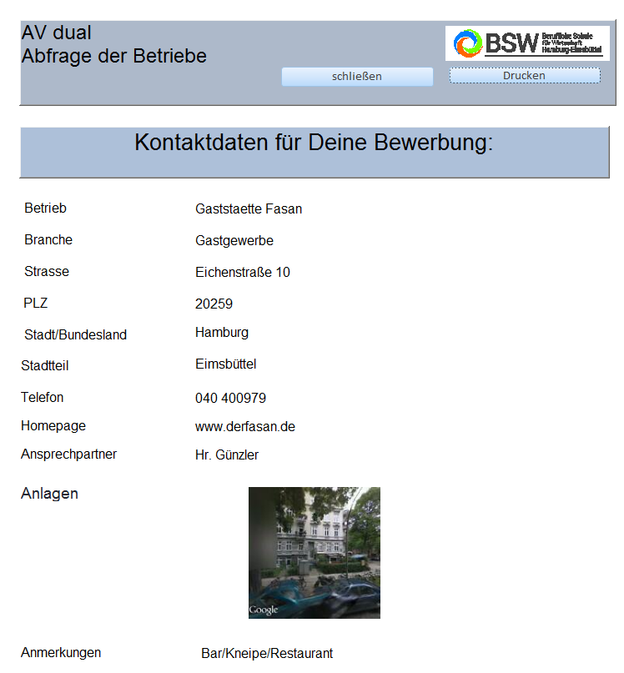
Enabling multiple Queries and Support
Multiple Queries
Handout for Pupils

Slide 17
Evaluation of the Database
Reduction of the required time for queries from hours to seconds
Flexible queries and effective matching
Quick provision of support material for pupils
Database comprises 400 companies
Feedback:
Additional features are favored

Slide 18
And the Future …
Required are concerted actions therefore a marketing plan would be the best solution
It is scheduled for 2018

Slide 19
SWORD (School and WOrk-Related Dual learning)
…elements and thoughts as basis for the core objectives…..
reduction of unemployment rates among young people
provision of subject matter experts for sustainable businesses
social cohesion
…..
It is up to you to make a difference ☺
Thank you for your attention
Gunnar Binda – gunnar.binda@vet-projekte.de * Hans Thormählen – Hans.Thormaehlen@hamburg.arbeitundleben.de

