Slide 1
BFI Upper Austria
SWORD
School and Work-
Related Dual learning
TRENTO 18/19.12.2014
www.bbrz-gruppe.eu

Slide 2
Overview
BBRZ GROUP Holding
Vocational Education
Vocational Rehabilitation
Vocational Integration
International
www.bbrz-gruppe.eu
Notes:
BBRZ GROUP is the largest provider of educational and social services in Austria

Slide 3

… new perspectives

Slide 4
Our mission
It is our mission and claim to provide assistance, support and encouragement to a maximum number of people of working age as they develop and utilize all occupational and social opportunities at their disposal.
Notes:
It is the BBRZ GROUP`s mission and claim to provide assistance, support and encouragement to a maximum number of people of working age as they develop and utilise all occupational and social opportunities at their disposal.

Slide 5

Austria´s biggest provider for VET and social services

Slide 6
Structure
Three strategic divisions
Vocational education and training (VET)
Vocational Rehabilitation
Vocational Integration
Notes:
We fulfil our mission by implementing three clear-cut, yet integral strategic lines of business:
Our companies in the Vocational Education line
ABZ Braunau
BFI OÖ
SOB – Steyr School of Social Care
Our Vocational Rehabilitation line encompasses the following companies:
BBRZ Reha GmbH
BBRZ Österreich
BBRZ Med
Jugend am Werk GmbH
Our companies in the Work and Placement line:
FAB
TEAMwork

Slide 7
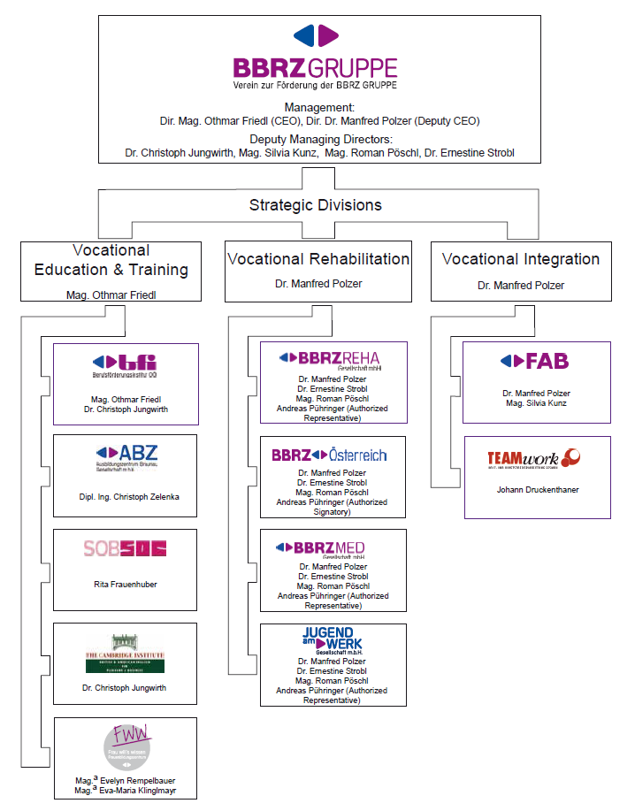
Structure
Notes:
Structurally divided into twelve legal entities

Slide 8
Figures
Employees:
Staff: 2.730
Employees with disabilities: 540
Workers in transit: 950
Participants:
110.000 people
Turnover:
236 Mio Euro

Slide 9
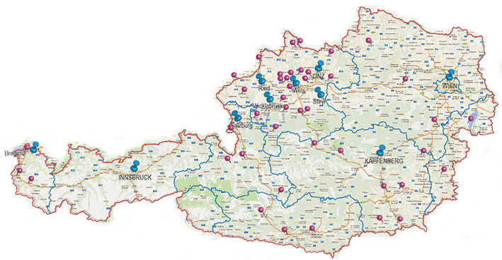
Regions / Sites
6 regions, 56 communities, 138 sites

Slide 10
Services
for:
Private customers
Companies
Federal states and local authorities
Institutions
Jobseekers
People with disabilities
People with a need for support
Migrants
Youths
People with a need for retraining

Slide 11


Internationally connected

Slide 12
International / Projects
150 international projects in the fields of Vocational Education and Training, Vocational Rehabilitation for people with disabilities and in the area of integration into the labour market have been succesfully implemented since 1992
Currently about 50 ongoing projects
Contracting partners
  European Commission
  ILO (International Labour Organisation) of the United Nations
  Council of Europe
  Governments and other bodies
Notes:
International cooperation
The EU supports innovative projects, exchange programmes and educational visits throughout Europe.

Slide 13
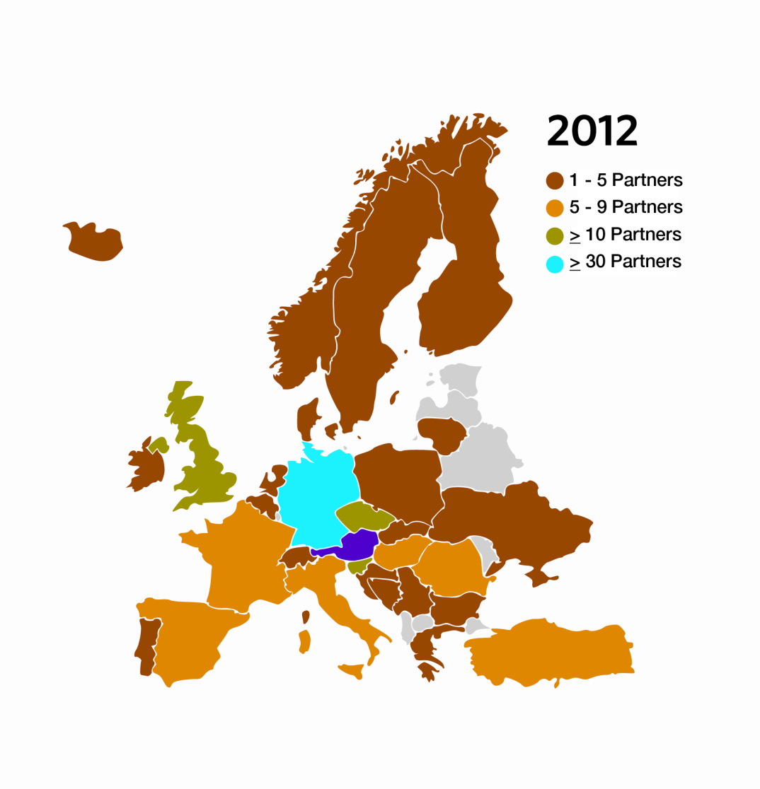
Partnerships
About 350 international network partners
Notes:
Participation in programmes such as the Lifelong Learning Programme or ESF Community Initiatives also involve international co-operation, which in turn provides new impulses.

Slide 14
International Networks
Member in several European Associations
ULIXES - European Union Training and Research Network (EEIG = European Economic Interest Group) - www.ulixesnet.eu
EASPD – European Association of Service Providers for Persons with Disabilities – www.easpd.eu
German Association for International Cooporation (GIZ) - www.giz.de
SOLIDAR – NGO network to advance social justice in Europe and worldwide - www.solidar.org
European Association of Institutes for Vocational Training (EVBB) – www.evbb.eu
Notes:
Therefore, bfi takes part in the development and implementation of transnational EU projects, either as the contractor or as a partner.

Slide 15

Example: EVBB
49 educational institutions from
21 European countries, China, Vietnam
And Sri Lanka with the objectives
To promote the quality of vocational education and training
To strengthen the competitive position of educational institutions and promoting the qualification of employees
To encourage and promote trans-national educational efforts along
with the exchange of information and experience
To aim at greater efficiency in vocational education and training
To increase the quality of VET – especially with regard to the needs of today’s labour market

Slide 16


Vocational Education and Training
Notes:
BFI OÖ is an Upper Austrian vocational training institution that meets the new requirements of labour in the 21st century
People in employment are offered a large variety of evening and weekend classes covering both vocational and personal subjects.
Highly committed trainers, innovative adult teaching methods and topical subjects guarantee that participants derive a personal benefit from attending bfi courses.

Slide 17





Vocational Education
FIGURES
Courses: 4.800
Turnover: 55,4 Mio Euro
Employees: 1.300
(including 1.200 trainers)
Participants: 52.000
5 regions with 45 sites
Market share in Upper Austria: 33 %
Vocational Education
Mag. Othmar Friedl
Dr. Christoph Jungwirth
DI Christoph Zelenka
Rita Frauenhuber
Mag. Eva-Maria Klinglmayer
Mag. Evelyn Rempelbauer
www.bfi-ooe.at
Notes:
We live in a world of continuously changing technologies, vocational profiles and qualification requirements.
Therefore, bfi has to adapt its training programmes accordingly to include new job requirements.

Slide 18
Vocational Education
OVERVIEW
Comprehensive provider in the field of adult education
Biggest provider for second chance education in Upper Austria and distance learning at university level
Market leader in social services and health care colleges
Reliable and compentent training organisation for skilled workers and apprentices in cooperation with companies
Developer and promoter of innovative projects
Training center for people with migrant background, NEET´s and youths in transiation from school to work
www.bfi-ooe.at
www.abz-braunau.at
www.sob-steyr.at
Notes:
Observation of the labour market, co-operations with the business and science sectors, international exchange of experience and internal quality management are the central prerequisites that enable us to quickly respond to changes in occupational life and to keep our training offers up to date.

Slide 19
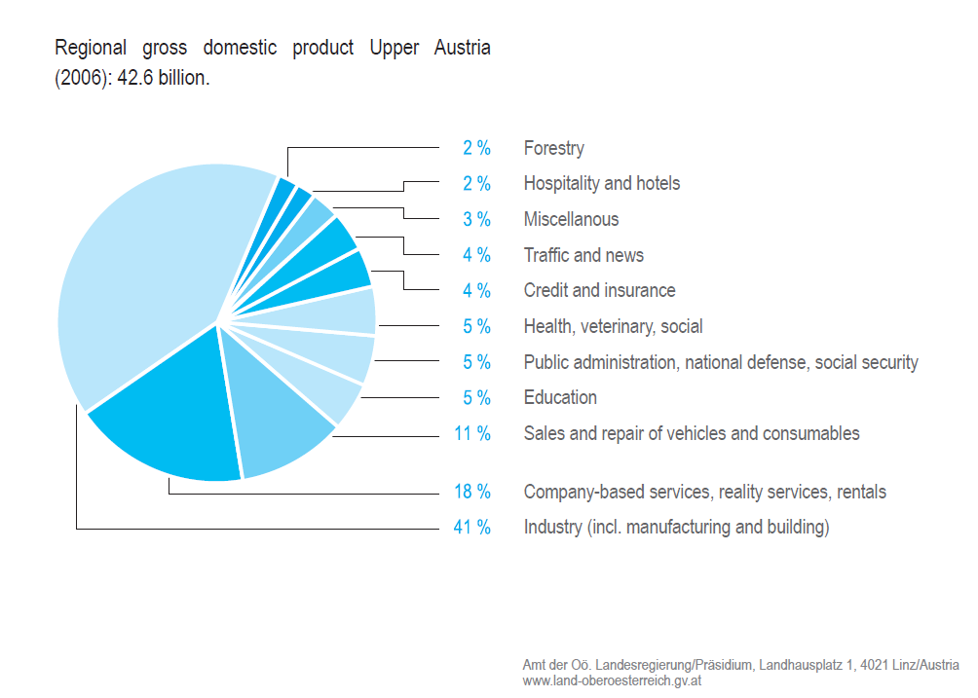

Upper Austria – Economy
http://www.land-oberoesterreich.gv.at/cps/rde/xbcr/ooe/OOe-Wirtschaft-E.pdf
www.bfi-ooe.at
Notes:
Upper Austria – Economy
Upper Austria is the leading region in Austria in terms of industry, exports
and technology. Around one quarter of industrial production and exports
in Austria stem from this region. Thus Upper Austria is considered to be
one of the most modern and competitive industrial regions within Europe.
A good education system is the key to successful development.
In Upper Austria, future-oriented education
and further training possibilities and measures for in-service
training are customized to satisfy the demands
and need of both citizens and the economy. The economic
area of Upper Austria is characterized by the
high level of qualification of its workforce which is guaranteed
by the dual vocational system.

Slide 20
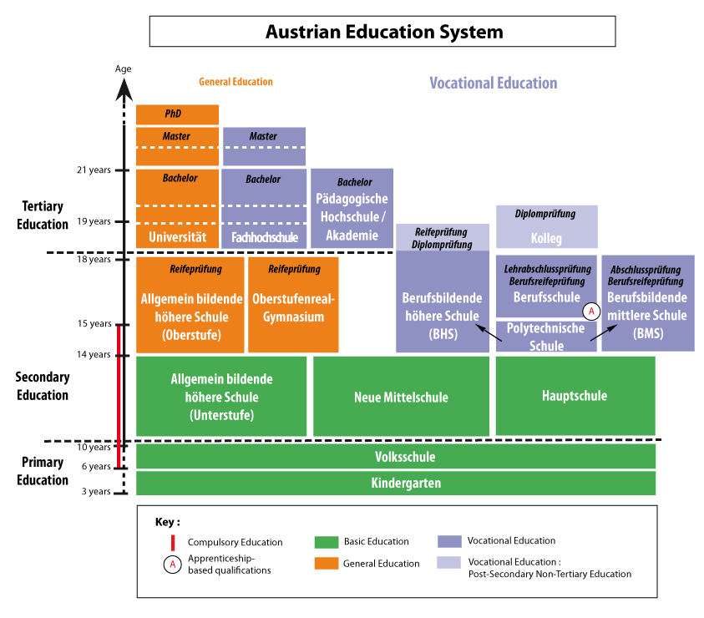
The vocational pathway in Austria
www.bfi-ooe.at
Notes:
The vocational pathway in Austria
Secondary education
One of the key characteristics of the Austrian system is to offer a choice between 2 different streams right at the outset of the 1st cycle of secondary education for pupils aged 10:
The Hauptschule (HS), the 1st cycle of secondary school which prepares pupils to discover occupational skills. The HS alone attracts 70% of pupils.
The Allgemein bildende höhere Schule (AHS), secondary schools providing mainstream education.
The Neue Mittelschule, a new school concept. Combines the teachings of the AHS and the Hauptschule.

Slide 21
The vocational pathway in Austria
www.bfi-ooe.at
Notes:
At the end of compulsory schooling (at the age of 14), corresponding to the 1st year of the 2nd cycle, the school system becomes further differentiated.
Four pathways are open to pupils, of which 3 offer VET, thereby underlining importance of this educational stream in Austria:
Mainstream secondary education leading to A-levels (Reifeprüfung, also called Matura), giving pupils access to tertiary education including university,
Long-term VET, (berufsbildend höheren Schulen or BHS), a 5-year course giving pupils access to university (for example technical and business institutes). This pathway awards 2 diplomas Reife und Diplomprüfung (A-levels and vocational diploma).
Medium-term VET (Berufsbildenden mittleren Schulen or BMS) providing full-time education over a 3- to 4-year course (for example, specialised technical and business schools). This pathway does not open the door to tertiary education, but does allow pupils to enter employment immediately after passing the final examination.
Vocational training and apprenticeship (Polytechnische Schule and Berufsschule) : consists of a polytechnic school year, followed by three years of learning (80% of the training time is spent in the workplace).

Slide 22

www.bfi-ooe.at

Slide 23
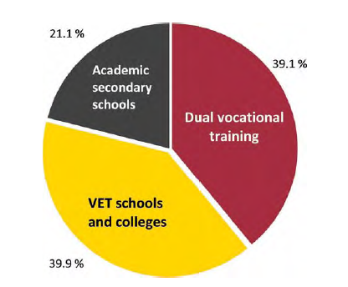
Initial vocational education and training
Source: Statistics Austria, BMUKK + ibw calculations
www.bfi-ooe.at
Notes:
Initial vocational education and training
Initial vocational education and training (IVET) is extremely important in Austria.
After completing their compulsory schooling period, about 40 % of young people
in Austria are trained in a legally recognised apprenticeship occupation, another
40 % opt for a VET school or college. This means that some 80 % of Austrian pupils
follow a vocational education and training pathway.
Initial vocational qualifications can be obtained by attending a dual VET
programme (apprenticeship and part-time vocational school) or in full-time
schools.
Full-time VET schools can be broken down into individual VET schools (e.g. schools of
engineering, arts and crafts; business schools; schools of management and services
industries), VET colleges (e.g. colleges of engineering, arts and crafts; colleges of
business administration; colleges of management and services industries; colleges
of tourism) as well as healthcare schools.

Slide 24
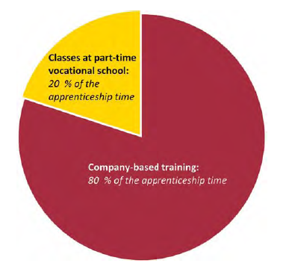
Apprenticeship:
Dual vocational training
Source: Statistics Austria, BMUKK + ibw calculations
www.bfi-ooe.at
Notes:
Apprenticeship: Dual vocational training
Graduates of an apprenticeship programme acquire a full vocational qualification
of a high standard.
The training in an apprenticeship occupation is open to all young people
who have completed their nine years of compulsory schooling. No specific
school qualification is required for access to an apprenticeship.
Training in the company and at part-time vocational school
There are significant differences between dual training in an apprenticeship
occupation and vocational education and training (VET) in full-time schools:
In the apprenticeship training system, the two places of learning are the
training company and part-time vocational school.
The apprentice is in a training relationship with his or her training company
and a student at a part-time vocational school at the same time.
The company-based part of dual vocational training makes up the major
part of the apprenticeship period.
The apprenticeship-leaving exam is taken in front of professional experts. The
focus of this exam is on the competences required for the respective profession.

Slide 25
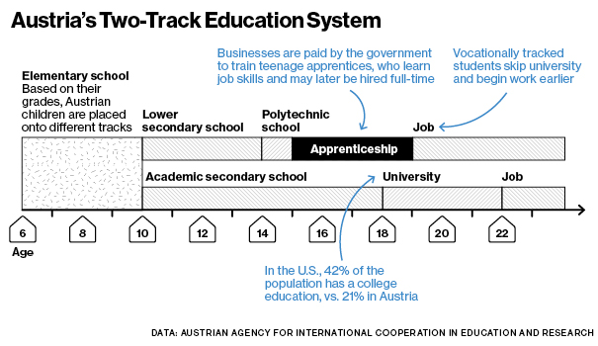
Why companies train apprentices
www.bfi-ooe.at
Notes:
Why companies train apprentices
Apprenticeship training is seen by companies as an investment in the future.
It enables companies to meet their future need for qualified skilled workers as best
as possible. Already during their training, apprentices carry out valuable work for
their training company.
Currently approximately 35,000 companies are open to young people as training
sites. By voluntarily providing apprenticeship training, companies show that they
accept social responsibility. By offering company-based training places, youth
unemployment is reduced and the future need for qualified skilled labour secured
at the same time.
Completion of the apprenticeship relationship, however, does not necessarily lead
to an employment relationship between the apprenticeship diploma holder and the
training company. Fully trained skilled workers can change to other companies, and
training companies can also recruit externally trained workers. This possible
fluctuation is a feature of a free VET system. Companies which invest in
apprenticeship training therefore do not only act in their own interest but make a
long-term contribution to the benefit of all economic sectors and professional
branches which have a demand for qualified apprenticeship graduates.

Slide 26
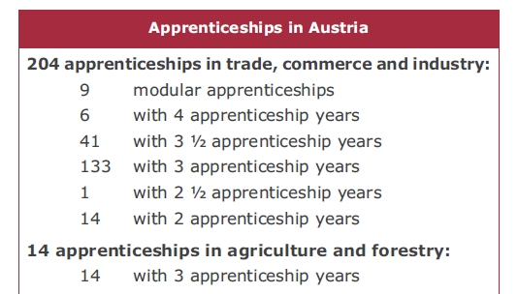
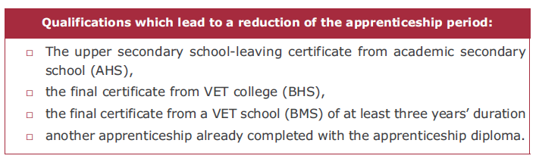
Apprenticeship occupations
www.bfi-ooe.at
Notes:
Apprenticeship occupations
In Austria there are 204 apprenticeship occupations in trade, commerce and
industry and 14 in agriculture and forestry (as
at autumn 2012). They are set up as individual, group, special-focus or modular
apprenticeships and regulated by federal legislation.
All legally recognised apprenticeships in trade, commerce and industry are laid
down in the list of apprenticeship occupations, which also specifies the
apprenticeship periods and relationships to other apprenticeship occupations
including credits awarded for already completed apprenticeship periods. The
currently set up apprenticeships are listed in the Annex.
Their legal bases are laid down in the Vocational Training Act (Berufsausbildungsgesetz
or BAG). For each individual apprenticeship occupation, the Minister
of Economy issues a training regulation, which is binding for the training
provided in training companies. Separate regulations have been issued for the
apprenticeships in agriculture and forestry: The principles of training in these
occupations are laid down in the Vocational Training Act for agriculture and
forestry (Land- und forstwirtschaftliches Berufsausbildungsgesetz or LFBAG). The
provinces adopt detailed regulations on that basis.
Training regulations stipulate the job profile specific to the respective apprenticeship
occupation. This job profile is the curriculum for the training company. It
contains – broken down by apprenticeship years – the professional competences
which the apprentice must be taught in company-based training. For newly
regulated apprenticeship occupations, not only job profiles but also activity
descriptions are formulated, which lay down, in the form of a short list, the
occupational requirements the trained apprentice is able to meet. The curriculum
of part-time vocational school is equivalent to the training regulation. In many
occupations, the job profile is supplemented by supportive training guidelines,
material and manuals.

Slide 27
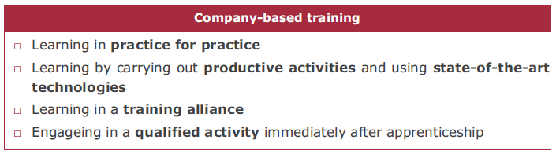
Company-based training
www.bfi-ooe.at
Notes:
Company-based training is characterised by the following features:
Initial vocational education and training is held under real-life working conditions.
The apprentice acquires the required knowledge and skills which are
laid down in the job profile for the respective apprenticeship occupation. Immediately
upon completion of the training, he or she is able to take up
a qualified professional activity as a skilled worker.
Most of the training is provided as part of productive activities; this reduces
costs and increases the apprentice’s motivation to learn.
Companies which cannot provide the job profile completely have the possibility
to use complementary practical training in a training alliance. In
some sectors, supra-company training centres (e.g. the “training construction
sites”) are established by businesses.

Slide 28
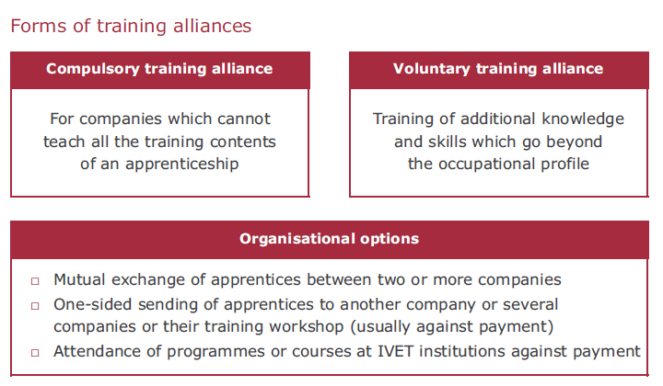
Training alliance
www.bfi-ooe.at
Notes:
Training alliance
Within the framework of a training alliance those companies can also train
apprentices where the knowledge and skills laid down for the apprenticeship
occupation cannot be fully imparted.
In this case the Vocational Training Act (Berufsausbildungsgesetz, BAG) provides for
a compulsory training alliance: It is permissible to provide training if
complementary training measures are conducted in another company or
educational institution (for example bfi) that are suited for this purpose. It must,
however, be possible to train the knowledge and skills vital for the
apprenticeship occupation mainly at the actual training company.
In the apprenticeship contract (or one of its appendixes), agreement on the training
content that will be imparted outside the actual training company as well as
“alliance partners” (suitable companies or institutions) is reached.
But it is also possible to enter into training alliances on a voluntary basis, if
training companies aim to impart special qualifications to apprentices - possibly
going beyond the occupational profile (e. g. special-purpose computer
programmes, foreign language skills, soft skills, etc.).
In some provinces institutionalised training alliances have been set up (such
as the Upper Austrian Corporate Training Alliance - FAV OO), which provide
information and support to companies about possible partner enterprises and
educational institutions and take on coordination of different training alliance
measures.

Slide 29
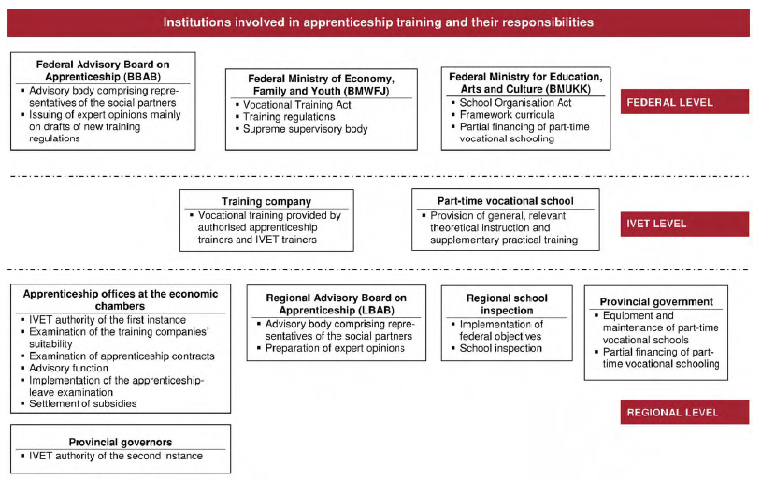
Competences
www.bfi-ooe.at
Notes:
Competences
The success and further development of the dual system are ensured by the
partnership of many institutions and establishments at various levels.

Slide 30
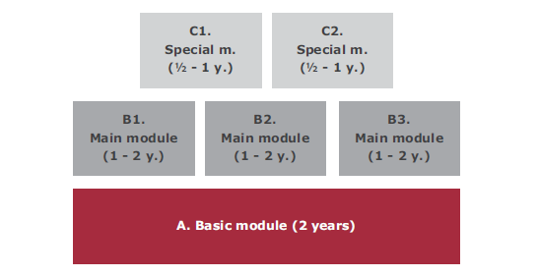
Modularisation of apprenticeship training
www.bfi-ooe.at
Notes:
Modularisation of apprenticeship training
The amendment to the Vocational Training Act (BAG) in January 2006 created the
possibility of modularising apprenticeships. This aims to improve the attractiveness
of apprenticeship training.
In modular apprenticeships, training comprises three modules:
Basic module
The basic module aims to impart the knowledge and skills required for carrying out
basic activities of the modular apprenticeship. The basic module has a minimum
duration of two years. In justified exceptional cases it can also be only one year.
Main module
The main module comprises the knowledge and skills required for exercising the
chosen specialisation (e. g. ventilation technology in the modular apprenticeship
“Installations and Building Technology”). It has a minimum duration of one year. The
combined duration of the basic and main module must be at least three years. Where
the basic module – as mentioned above – only takes one year in justified exceptional
cases, the main module must have a minimum duration of two years.
Special module
The special module aims to impart the knowledge and skills for special services,
products or their production. It covers a training period of half a year or a full year.
Within this system it is possible to combine different modules: Every apprentice in
a modular scheme is obliged to complete the basic module and select a main
module. In addition, the apprentice can be trained in another main module or
one or more special modules. It must be noted that the overall training period
must not exceed the maximum total apprenticeship period of four years. The
combination of modules must already be selected when concluding the
apprenticeship contract – therefore at the beginning of the apprenticeship period.
Although it is possible to change between the modules, this will lead to a change
in the apprenticeship contract.
Benefits of modularisation
The option of combining different modules in the case of modular apprenticeships
offers the benefit for companies and apprentices that training can be designed
more flexibly.
But it is not only in the training design that there is increased flexibility. When
introducing new training content, wider scope for action is also created by this
modular system. Rather than modernising an entire apprenticeship or adapting it
to urgent skills requirements of the economy, modular apprenticeships also allow
individual modules to be exchanged or updated. This makes quicker responses to
changing sectoral requirements possible.
Thanks to modularisation it is no longer absolutely necessary to introduce a
completely new apprenticeship occupation. Instead it is possible to add new
training content to existing systems in the form of modules. This has the advantage
that the number of individual apprenticeships does not rise continually, which leads
to enhanced transparency of the apprenticeship occupation landscape.
But modularisation does not only have benefits when apprenticeships are
introduced or modernised, existing individual apprenticeships can also be combined
in a modular system if contents overlap. This can lead to a useful reduction of
the number of apprenticeships (while maintaining training diversity), which
improves clarity.

Slide 31
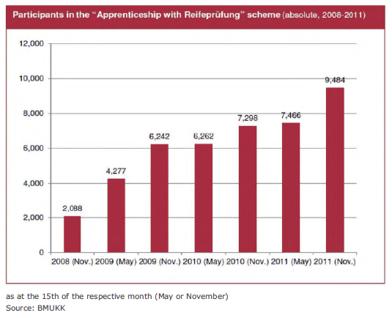
Apprenticeship and Matura
www.bfi-ooe.at
Notes:
Apprenticeship and Matura
Berufsmatura: Apprenticeship diploma plus certificate of secondary
Education
Thanks to the introduction of the Berufsmatura certificate, which provides general
access to higher education for skilled workers and graduates of three- to four-year
full-time VET schools, apprenticeship training also forms a good basis for the tertiary
education sector. Since autumn 2008 all Austrian apprentices have had the possibility
to complete the Berufsmatura exam free of charge and parallel to apprenticeship
training.
The Berufsmatura (also termed Berufsreifeprüfung) certificate entitles holders to
access higher education in Austria. This means that they can attend universities,
universities of applied sciences (Fachhochschulen), university colleges of education,
post-secondary VET courses, and other programmes which can only be attended by
holders of the certificate of secondary education (Reifeprüfung).
Within the framework of the Berufsreifeprüfung exam, the following four partial
exams must be taken:
German
mathematics
modern foreign language
specialist area exam (corresponding to the apprentice’s occupational area).
Three partial exams (German, mathematics and modern foreign language) can
already be taken during apprenticeship training. The last partial exam can
only be taken after the apprenticeship-leaving exam by people aged 19 or over.
Only in four-year apprenticeships is it also possible to take the partial exam on the
specialist area within the framework of the apprenticeship-leaving exam.

Slide 32
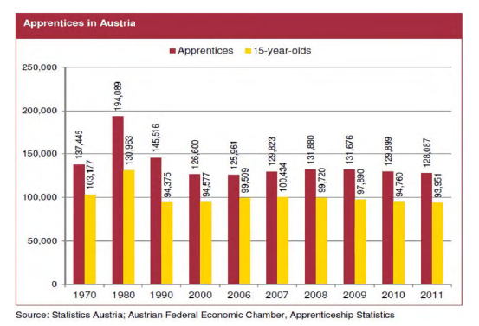
Facts & figures
www.bfi-ooe.at
Notes:
Facts & figures
In all sectors, new and modernised occupational profiles ensure that the
attractiveness of apprenticeship training for young people is enhanced and the
companies’ willingness to train young skilled workers is maintained.
Currently 128,087 apprentices are in a training relationship in Austria. In late 2011
the number of apprenticeship beginners was 38,485. This means that the slight
decline in apprenticeship figures due to the decreasing number of young people is
continuing.

Slide 33
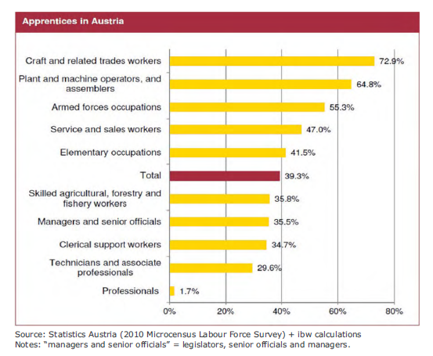
Occupational status
www.bfi-ooe.at
Notes:
Occupational status
The apprenticeship graduates’ occupational status and professional activities show
that they are the potential skilled workers of the Austrian economy. The highest
share of apprenticeship graduates can be identified in the occupational group of
craft and related trades workers (73 %). Among managers, the share of
people with an apprenticeship diploma as their highest qualification is 35.5 %. The
occupational group of technicians and associate professionals reveals a proportion
of apprenticeship graduates of almost one third.
In 2010, 88.5 % of economically active apprenticeship graduates were employed
in line with their training. A percentage of 11.5 % of the workforce with an
apprenticeship as their highest educational attainment were employed in the group
elementary occupations.

Slide 34
Our mission – Dual(Trial) Systems
(Integrative) Vocational Training in Austria
different ways
www.bfi-ooe.at
Notes:
To develop a culture of work-based learning requires cooperation beyond the education and training sector. Policies for education and training, employment, social welfare and economic development should be complementary. All stakeholders, government authorities, social partners, sector organisations, VET schools/institutions, public employment services and guidance and counselling services need to cooperate.

Slide 35
The Austrian way to apprenticeship
apprenticeship examination
Integrative VET Training
VET Training
The regular way to the apprenticeship 3, 3,5 or 4 years
„Du kannst was“
The VET way only for adults –
18 month
school of production
vocational guidance and counselling
educational, vocational and personal guidance
the end of compulsory schooling
www.bfi-ooe.at

Slide 36
Integrative VET Training for young peoples
Career Guidane
Integrative Vocational Training
Phase 1
Partial Qualification
Integrative Vocational Training
3rd year of apprenticeship
Final apprenticeship examination
Integrative Vocational Training –
Phase 2
1st year of apprenticeship
Integrative Vocational Training
2nd year of apprenticeship
Vocational school
Vocational training
real-life working
www.bfi-ooe.at

Slide 37
VET Training for young peoples
Career Guidane
Final apprenticeship examination
Vocational Training
1st year of apprenticeship
Vocational Training
2nd year of apprenticeship
Vocational Training
3rd year of apprenticeship
Vocational Training
4rd year of apprenticeship
Vocational school
Vocational training
real-life working
www.bfi-ooe.at

Slide 38
skilled-worker training
Career Guidane
Final apprenticeship examination
18 mouths
experience
Vocational Training
Vocational training
real-life working
www.bfi-ooe.at

Slide 39
“Du kannst was”
5 years
experience
Career Guidane
Vocational Training
3 Workshops
Qualicheck I
Qualicheck II
=
Final apprenticeship examination
Vocational training
real-life working
www.bfi-ooe.at

Slide 40
Vocational education and training
“No educational path in Austria ends in a blind alley,”
summarizes the Federal Minister for Education.
www.bfi-ooe.at
Notes:
Vocational education and training (VET) is very popular among young people with nearly 80% of pupils going into this field when they leave compulsory schooling. Its particularity is to combine mainstream education, vocational training and practical training for 14 to 19 year-olds.
The educational pathways are flexible and “second chance education” (Zweiter Bildungsweg) is well established.

Slide 41
expectations / role in the project
benchmarking analysis
approach/education-to-labour-market transition model
pathways and tools
drawing up of the manual
study visit organization in austria
www.bfi-ooe.at

Slide 42

www.bfi-ooe.at

