Slide 1



SWOT Analysis
SWORD (School and WOrk-Related Dual learning)
First Results in the Autonomous Province of Trento
Daniela Carlini
PROVINCIA AUTONOMA DI TRENTO

Slide 2

Reminder: the Pilot Action in Trento
The pilot in the PAT "I Fuoriclasse: Success
stories" wants to build a inter-disciplinary scheme,
based on problem-solving models.
It aims to let young participants (NEETs) increase their skills through the development of a real project including internship periods in a company.
The overall goal is the acquisition of cross-disciplinary skills all along the planned activities (teaching, laboratory and apprenticeship), and give young people the opportunity to continue their training through a “standard” apprenticeship or complete their training at school.

Slide 3
The SWOT Analysis
Strengths
Weaknesses
Opportunities
Threats

Slide 4
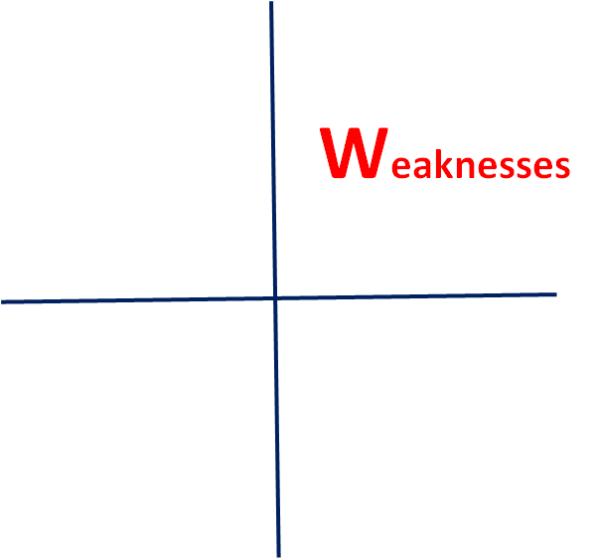
Weaknesses
- Small number of participants (only 10)
- Difficult families, often unable to be involved in the project
- Difficult integration with standard training courses
- The structure of the pilot is rather rigid
- Trainers and tutors are prepared for standard training courses, it is the first time they work in a multidimensional action (training, social, job placement)
- Difficult connection with other services (social, employment, other training centers and school institutions)
- Few companies willing to host trainees with the
perspective of further apprenticeships for qualification
(we need companies socially sensitive)

Slide 5
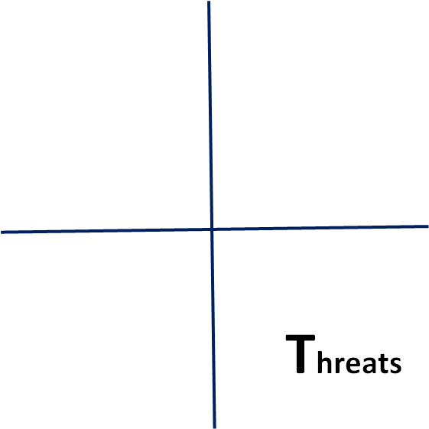
Threats
- Identifying & involving companies. For social enterprises, as we have the "Family audit" model, we can work on “Company audit"
- Risk of students leaving the scheme. We must work on:
- concentration: learn to stay focused on what you are studying or doing;
- motivation: learn how to handle moments in which they are ready to leave
("I cannot do it"), as well as moments of start again and euphoria ("I do it");
- keeping - resilience: learning how to handle moments of difficulty in the different phases of training and job placement;
- mastering soft-skills (learning their importance to study, to work, and more generally to live);
- Training the trainers: their skills must be extended,
it Is important to collect more information concerning
similar experiences.

Slide 6
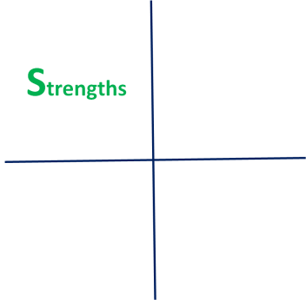
Strengths
- Using didactic methodologies different from the traditional ones
- Focus on real tasks, more clear to be understood
- Organisation of company visits, verification of projects and tasks on the field
- Identification of companies with a social sensibility
- Flexibility in the training course, overcoming students’ difficulties: alternation between internships and laboratories, as well as time for being attentive and for learning
Effective support from external professionals and
trainers
- Tutor support for both students and families

Slide 7

Opportunities
- Increase contacts with institutional networks (social services, employment services) and other training centres
- Extend the model to other courses in the pilot training center and with other training institutions
- Increase contacts with companies (awareness actions to business, trade associations, social partners)
- Customize the courses taking into account the small number of participants, to meet the special constraints (e.g. flexibility in time, integration between training and social actions

Slide 8

Conclusions
With reference to the 20 guiding principles set up by the European Commission, High-performance apprenticeships & work-based learning, the pilot responds to:
Principle 4: Systematic cooperation between VET schools or training centres and companies
Principle 9: Supporting companies providing apprenticeships for disadvantaged learners
Principle 11: Promoting the permeability between VET and
other educational and career pathways

Slide 9
Thanks for your attention
To bridge the gap between learning and labour market, companies have to play an active role in the vocational education system.
In short, there is no dual system without companies.
Bertelsmann Foundation
There is no dual system without schools.
Export of the Dual Model of
Vocational Education and Training
Promises and Pitfalls
Prof. Dr. Philipp Gonon
University of Zurich,

