Slide 1

School and Work-Related Dual learning
SWORD
4th Project Meeting
Gdansk (PL)11th – 13th May 2016
Regione Autonoma Friuli Venezia Giulia
AREA ISTRUZIONE, ALTA FORMAZIONE E RICERCA

Slide 2
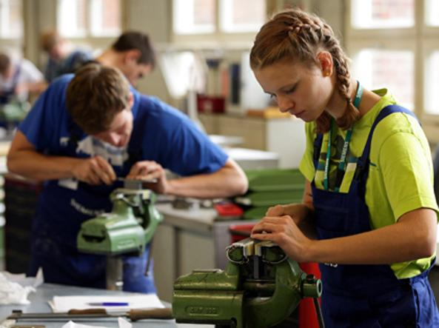
School and work Alternance : some informations and data
Law n. 107/2015
«La buona scuola – THE GOOD SCHOOL»
The aim is to increase job opportunities and labour market guidance skills of students
School-work alternance schedules are realized by Professional and Technical superior schools and last 400 hours during the third and fourth class. And by High Schools for a duration of 200 hours during the third, the fourth and the fith years.
art.1, comma 33

Slide 3

School and work Alternance : some informations and data
Regional Law 13/2015
We have build up a specific agency for labour market
The regioanl Administration is able to plan, to coordinate and promote the quality, the guidance service monitoring and providing of specialistic guidance services.
Planning function
Providing services to people
ACTIVITIES
NATIONAL
REGIONAL
- PARTICIPATION
INTERNATIONAL PROJECTS
OPERATORS TRAINING
INFORMATION SERVICES
MONITORING
GUIDANCE OFFER CATALOGUE
- TOOLS TO BETTER KNOW DIFFERENT JOBS

Slide 4

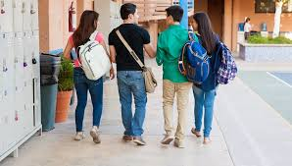
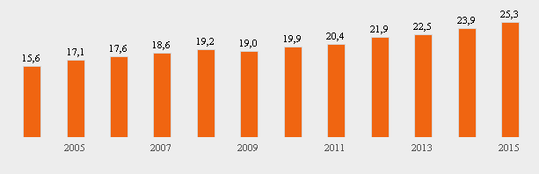
School and work Alternance : some informations and data
20.000 Students
Superior schools (III-IV-V)
2015
30-34 years old people with university degree
FVG 27,0%
ITALIA 25,3%
2020 European Strategy the european average at 40%
dati http://noi-italia.istat.it/
2015
Notes:
4

Slide 5
THE ITALIAN DUAL SYSTEM
SCHOOLS
FVG REGION
SCHOOL REGIONAL OFFICE
LOCAL PUBLIC BODIES
BUSINESS SECTOR
UNIVERSITIES – HIGHER EDUCATION SYSTEM
RESEARCH BODIES

Slide 6
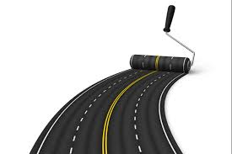


School-work alternance
FRAMEWORK AGREEMENT BETWEEN ALL DUAL SYSTEM ACTORS
SHARING
SERVICES TO SUPPORT THE COURSES
LIST OF HOSTING STRUCTURES
SCHOOL/WORK ALTERNANCE
Notes:
6

Slide 7

School and work alternance (secondary schools)
3° year
4° YEAR
5° YEAR
PREPARATORY ACTIVITY
SELF ASSESSMENT OF INTERESTS AND SKILLS
EXPLAIN EXPECTATIONS ABOUT THE FUTURE JOB
KNOWLEDGE ABOUT THE ECONOMIC ASSETS OF THE TERRITORY
KNOWLEDGE OF PROFESSIONAL PROFILES
KNOWLEDGE OF LABOUR MARKET
ENHANCE THE SKILLS RELATED TO SAFETY AT WORK
REFLECTIVE ACTIVITY OF REALIZED EXPERIENCE (EVALUATION)
SELF ASSESSMENT OF GAINED SKILLS
ASSESSMENT OF SKILLS REQUESTED BY THE LABOUR MARKET
ASSESSMENT OF EFFICACY OF ITS OWN WORK STYLE AND BEHAVIOUR
ASSESSMENT OF ASSETS THATA VALIDATE THE PROFESSIONAL AND EDUCATIONAL CHOICE
KNOWLEDGE ABOUT TRAINING OPPORTUNITIES AFTER THE DIPLOMA
EXPERIENCE
EDUCATIONL
GUIDANCE
RE-BUILD THE
PERSONAL
EDCUATIONAL AND PROFESSIONAL
TRAIL

Slide 8
Services to support the dual system provided by FVG REGION
TRAINING
TECHNICAL ASSISTANCE
OPERATORS
GUIDANCE
SAFETY AT WORK
LOCAL DEVELOPMENT DYNAMICS
GOVERNANCE AND MANAGEMTN OF THE AGREEMENT
TO SCHOOLS TO PERSONALIZE COURSES AND TRAILS FOR SCHOOL AND WORK ALTERNANCE

Slide 9
HOW CAN SWORD IMPROVE THE REGIONAL SYSTEM?
STUDENTS
TEACHERS/SCHOOLS
TRAILS
TO KNOW THE ALTERNANCE SYSTEM FOR SCHOOL AND WORK (GUIDANCE)
TO KNOW PROFESSIONAL PROFILES MOST APPROPRIATE FOR ITS OWN ABILITIES AND PECULIARITIES
TO IMPROVE SKILLS TO MANAGE ITS OWN TRAINING AND PROFESSIONAL CAREER
NEW METHODOLOGIES APPROPRIATE WITH AKTERNANCE SHOOL AND WORK TOOLS
TOOLS TO SUBSTAIN THE DIALOGUE WITH OTHER TERRITORIAL PARTNERS
MONITORING OF SET UP ACTIVITIEES
OPPORTUNITY TO TEST SOME MODELS OF A DUAL SYSTEM INSIDE THE LOCAL CATALOGUE OF TRAIING OFFER

Slide 10

Thanks for your attention!
orientamento@regione.fvg.it

