Slide 1

Pilot projekt
Wilhelm Hinterberger
Gdandk 11 – 13.04.2016
www-bfi-ooe.at

Slide 2

Motivation
The main motivation of this pilot is offering youths (unaccompanied minors) who are entitled to asylum the means so that they can participate in the formal educational system, gain a school leaving qualification and access the formal vocational training system.
The target group of participants is extremely diverse. Any form of long-lasting integration needs to take into consideration the individual experience and encourage reflection of decision-making and responsibilities.
www.bfi-ooe.at

Slide 3

Target-group
Refugee Minors aged 15 to 24 who have been more than three years in the status "eligible for asylum" (subsidiary protection or convention refugees) who need German language training and career counselling;
Youth entitled to political asylum, who want to prepare for work and gain a school qualification (optional) since some have an interrupted education in the country of origin.
www.bfi-ooe.at

Slide 4

Objectives
The pilot seeks to prepare unaccompanied refugee minors and youth entitled political asylum for the labour market, improve their self-esteem and foster personal responsibility for career development.
The intention is to facilitate both the social and work integration of refugee minors through education (language learning) and career advice and planning.
www.bfi-ooe.at

Slide 5

Aims
Acquisition of language skills (German)
Social and personal competence training, including intercultural competence
Reading, writing and arithmetic
Preparation for compulsory school certificate
Acquisition of basic ICT skills
Explore occupations through career advice and job information
Support participants in developing personal goals
Support participants in reviewing their skills and abilities
Discover skills, dispositions and gain work experiences through practice (providing hands on opportunities)
Explore personal competence and personal perspective and convey personal details in the way that presents participants in the best possible light (career planning)
Political and intercultural education (understand a new country’s culture and rules, such as the way of socialising).
Social education
www.bfi-ooe.at

Slide 6

Needs/weakpoints
We would like to exchange on didactics, methodology and learning outcomes
In particular on methodological competence (Methodenkompetenz)
Ability to use techniques, follow processes and apply learning strategies.
Methodological competence includes the ability to obtain information, structure, reuse, represent, interpret results of processing operations properly and to present them in a suitable manner. They also include the ability to apply problem-solving techniques and the design of problem-solving processes. They gain in importance due to new ways of structuring work (job enrichment, partially autonomous working groups).
www.bfi-ooe.at

Slide 7

Pilot Actors
Pilot Coordination Team
bfi OÖ
AMS – Austrian Public Employment Service
Pilot Cooperation Partners
hosting enterprises
Pilot Target Group
Refugee Minors aged 15 to 24 who have been more than three
years in the status "eligible for asylum“
Benefit: Apprenticeship Contract
www.bfi-ooe.at

Slide 8
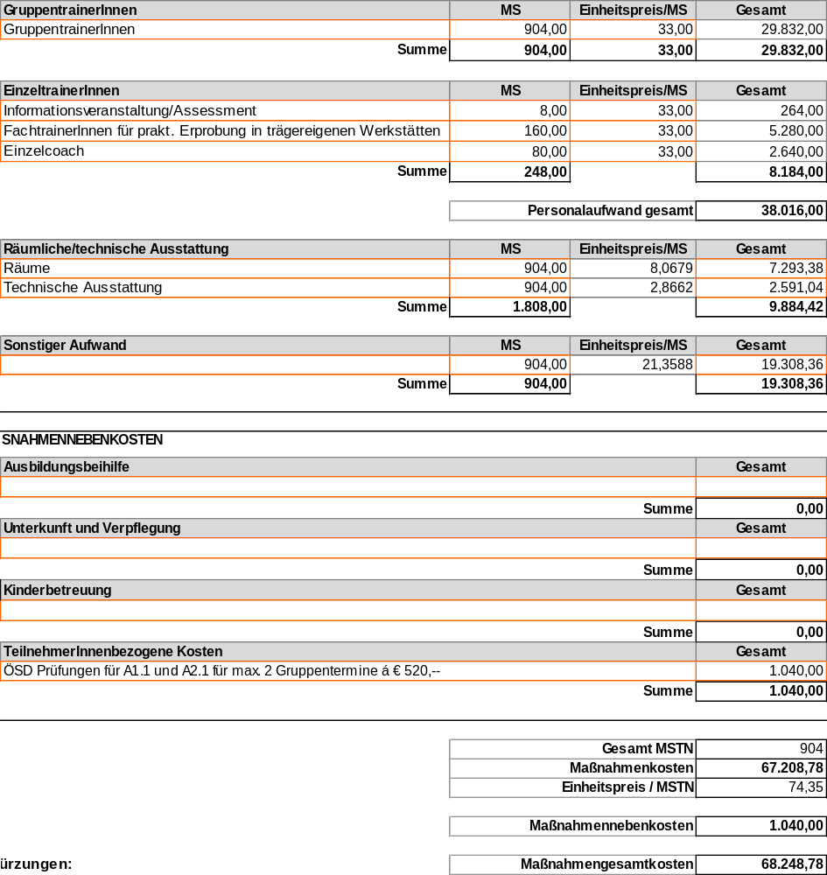

Pilot Costs
The pilot is financed through the Austrian Public Employment Service (AMS). AMS is Austria’s leading provider of labour market related services.
www.bfi-ooe.at

Slide 9
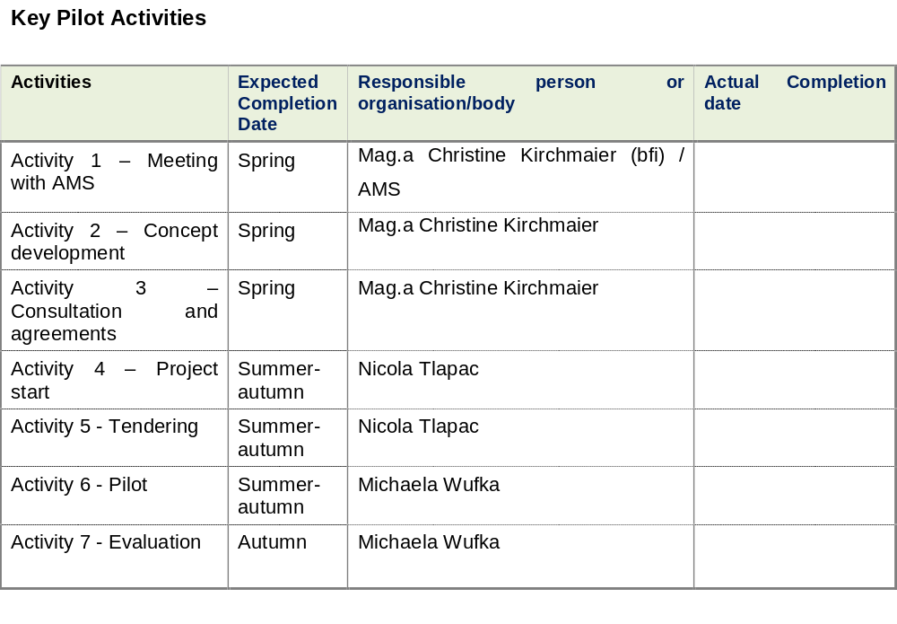

Pilot Schedule
www.bfi-ooe.at

Slide 10
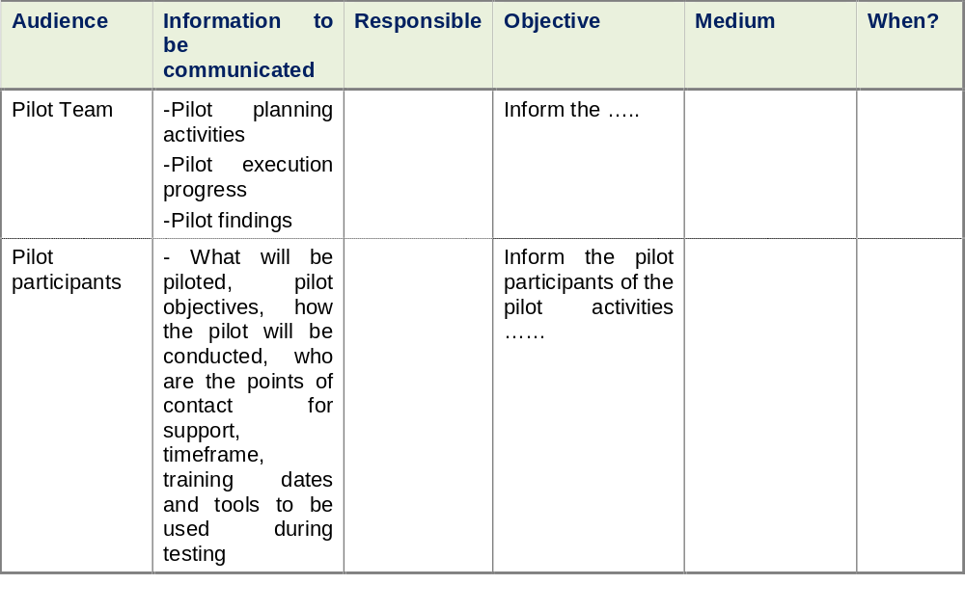

Communication Strategy
www.bfi-ooe.at

Slide 11


www.bfi-ooe.at

